Slide 1
Message to SDA Leaders and Pastors

Slide 2
Woe be unto the pastors that destroy and scatter the sheep of my pasture! saith the LORD. Therefore thus saith the LORD God of Israel against the pastors that feed my people; Ye have scattered my flock, and driven them away, and have not visited them: behold, I will visit upon you the evil of your doings, saith the LORD. (Jeremiah 23:1-2)

Slide 3
Therefore, ye shepherds, hear the word of the LORD; As I live, saith the Lord GOD, surely because my flock became a prey, and my flock became meat to every beast of the field, because there was no shepherd, neither did my shepherds search for my flock, but the shepherds fed themselves, and fed not my flock; Therefore, O ye shepherds, hear the word of the LORD; Thus saith the Lord GOD; Behold, I am against the shepherds; and I will require my flock at their hand, and cause them to cease from feeding the flock; neither shall the shepherds feed themselves any more; for I will deliver my flock from their mouth, that they may not be meat for them.
(Ezekiel 34:7-10)

Slide 4
Many pastors have destroyed my vineyard, they have trodden my portion under foot, they have made my pleasant portion a desolate wilderness.
{Jeremiah 12:10}

Slide 5
My people hath been lost sheep: their shepherds have caused them to go astray, they have turned them away on the mountains: they have gone from mountain to hill, they have forgotten their resting place.
{Jeremiah 50:6}

Slide 6
That which hath been is now; and that which is to be hath already been; and God requireth that which is past.” {Ecc 3:15}
Now all these things happened unto them for ensamples: and they are written for our admonition, upon whom the ends of the world are come. {1 Cor 10:11}
'Not unto themselves, but unto us they did minister the things, which are now reported unto you by them that have preached the gospel unto you with the Holy Ghost sent down from heaven; which things the angels desire to look into' (1 Peter 1:12)

Slide 7
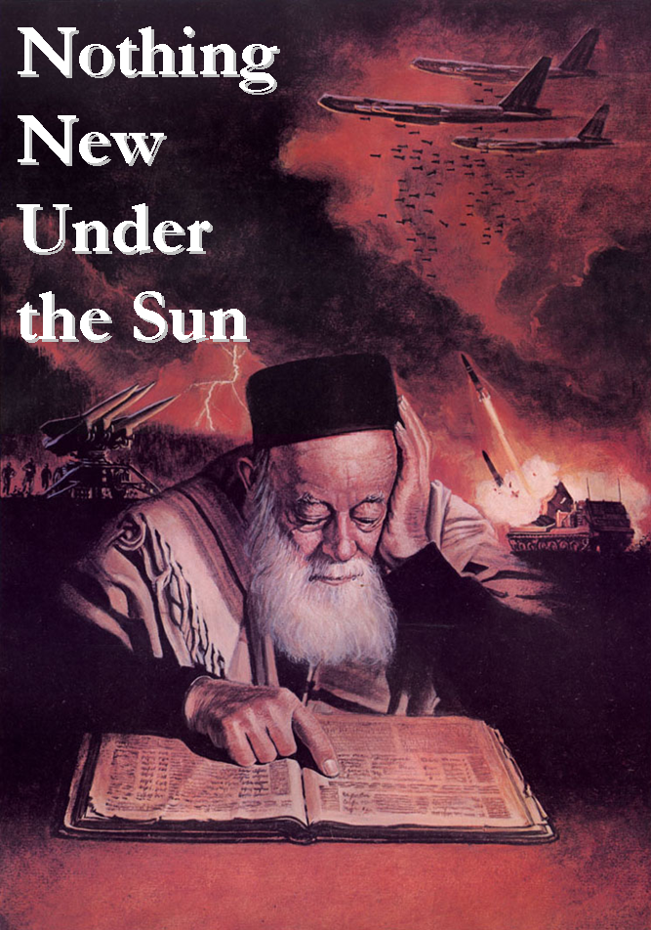
“Each of the ancient prophets spoke less for their own time than for ours, so that their prophesying is in force for us”.
E.G. White, Selected Messages, vol. 3, p. 338.

Slide 8
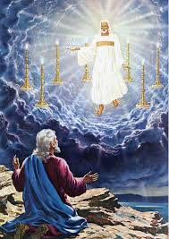
Rev 1:20
The mystery of the seven stars which thou sawest in my right hand, and the seven golden candlesticks. The seven stars are the angels of the seven churches: and the seven candlesticks which thou sawest are the seven churches.

Slide 9
“His hand are seven stars, representing the ministers of the churches. Out of His mouth issues a sharp, two-edged sword, an emblem of the power of His word.” –
{SL 77.1}

Slide 10
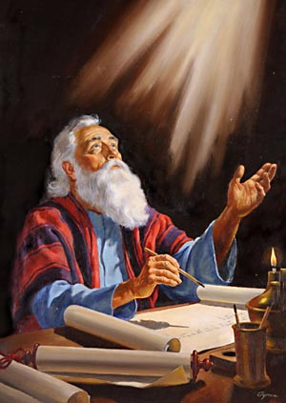
And unto the angel of the church of the Laodiceans write; These things saith the Amen, the faithful and true witness, the beginning of the creation of God; I know thy works, that thou art neither cold nor hot: I would thou wert cold or hot. So then because thou art lukewarm, and neither cold nor hot, I will spue thee out of my mouth. Because thou sayest, I am rich, and increased with goods, and have need of nothing; and knowest not that thou art wretched, and miserable, and poor, and blind, and naked: {Rev 3:14-17}

Slide 11
“It is a solemn statement that I make to the church, that not one in twenty whose names are registered upon the church books are prepared to close their earthly history, and would be as verily without God and without hope in the world as the common sinner. They are professedly serving God, but they are more earnestly serving mammon. This half-and-half work is a constant denying of Christ, rather than a confessing of Christ. So many have brought into the church their own unsubdued spirit, unrefined; their spiritual taste is perverted by their own immoral, debasing, corruptions, symbolizing the world in spirit, in heart, in purpose, confirming themselves in lustful practices, and are full of deception through and through in their professed Christian life. Living as sinners, claiming to be Christians. {CHS 41.1}

Slide 12
Eze 8:16;
“And he brought me into the inner court of the Lord's house, and, behold, at the door of the temple of the Lord, between the porch and the altar, were about five and twenty men, with their backs toward the temple of the Lord, and their faces toward the east; and they worshipped the sun toward the east.”

Slide 14
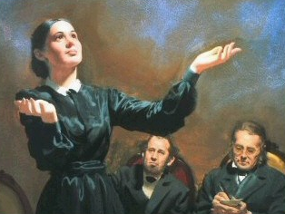
This compromise between paganism and Christianity resulted in the development of the “man of sin” foretold in prophecy as opposing and exalting himself above God. That gigantic system of false religion is a masterpiece of Satan's power,—a monument of his efforts to seat himself upon the throne to rule the earth according to his will. {GC88 50.1}

Slide 15
“Babylon is said to be the mother of harlots. By her daughters must be symbolized churches that cling to her doctrines and traditions, and follow her example of sacrificing the truth and the approval of God, in order to form an unlawful alliance with the world. The message of Revelation 14 announcing the fall of Babylon, must apply to religious bodies that were once pure and have become corrupt. Since this message follows the warning of the Judgment, it must be given in the last days, therefore it cannot refer to the Romish Church, for that church has been in a fallen condition for many centuries. Furthermore, in the eighteenth chapter of the Revelation, in a message which is yet future, …

Slide 16
the people of God are called upon to come out of Babylon. According to this scripture, many of God's people must still be in Babylon. And in what religious bodies are the greater part of the followers of Christ now to be found? Without doubt, in the various churches professing the Protestant faith. At the time of their rise, these churches took a noble stand for God and the truth, and his blessing was with them. Even the unbelieving world was constrained to acknowledge the beneficent results that followed an acceptance of the principles of the gospel. In the words of the prophet to Israel, Thy renown went forth among the heathen for thy beauty; for it was perfect through my comeliness, which I had put upon thee, saith the Lord God. …

Slide 17
But they fell by the same desire which was the curse and ruin of Israel,—the desire of imitating the practices and courting the friendship of the ungodly. “Thou didst trust in thine own beauty, and playedst the harlot because of thy renown.”
Many of the Protestant churches are following Rome's example of iniquitous connection with the kings of the earth; the State churches, by their relation to secular governments, and other denominations by seeking the favor of the world. And the term Babylon—confusion—may be appropriately applied to these bodies, all professing to derive their doctrines from the Bible, yet divided into almost innumerable sects, with widely conflicting creeds and theories. {GC88 383.1}
Besides a sinful union with the world, the churches that separated from Rome present other of her characteristics. {GC88 383.2}

Slide 18
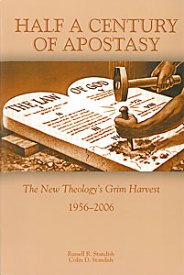

Slide 19
“The most noticeable changes concerned the presentation of seventh day Adventists understanding of the human nature of Christ and our consequent understanding of righteousness by faith. Further many believed that the Seventh Day Adventist church views of the mark of the beast, Babylon, the sanctuary, the atonement and the Spirit of Prophecy were seriously muted, if not effectively destroyed. Our faith was effectively destroyed, its central doctrines compromised.

Slide 20
Barnhouse and Martin were pleasantly surprised with the doctrine alterations which they noted in answers to their questions and felt that these were of sufficient significance to merit the announcement which they made indicating SDA should be removed from the category of sects and placed among the group of true believers for Christ.
Half a century of Apostasy - Standish

Slide 21
“On Wednesday April 17, 21 Seventh-day Adventist pastors joined four hundred Anglicans, Pentecostals, Salvation Army, Methodists and other denominations for an "Adventures in Evangelism" seminar sponsored by the Willow Creek Association, Chicago, USA. The main speakers, Lee Strobel and Mark Mittelberg are leaders in the organisation that has become famous in Christian circles around the world, for its "Seeker Services" and reaching the secular mind…….. Whatever the views of the participating Adventist pastors, two things can be said about the seminar: it was very well organised, and Willow Creek have a clear vision for meaningful and relevant contemporary evangelism. Certainly the day offered useful pointers and stimulated the mind to evaluate our own evangelistic methods and styles” (Entered from Dalbert Elias delias@adventist.org.uk in BUC news April 24, 1999) [http://www.tagnet.org/adventist.fm/lnews.htm lnews.html]

Slide 22
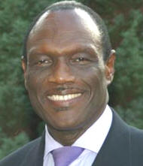
“So I for one welcome Pope Benedict to Britain and will not be seeking in any way to embarrass him on his visit here. Neither should any Seventh-day Adventist. We could also take the opportunity to let our Catholic friends know that we are pleased that their leader has come to see them. At the same time we must look for opportunities to share with our Catholic friends what we understand as God’s message for us and them during these last days: they and everyone else need to know that each of us can approach the throne of grace with confidence and receive forgiveness for our sins”

Slide 23
“Thus the message of the third angel will be proclaimed. As the time comes for it to be given with greatest power, the Lord will work through humble instruments, leading the minds of those who consecrate themselves to his service. The laborers will be qualified rather by the unction of his Spirit than by the training of literary institutions. Men of faith and prayer will be constrained to go forth with holy zeal, declaring the words which God gives them. The sins of Babylon will be laid open. The fearful results of enforcing the observances of the church by civil authority, the inroads of Spiritualism, the stealthy but rapid progress of the papal power,—all will be unmasked. By these solemn warnings the people will be stirred.” {GC 607}

Slide 24
“If God abhors one sin above another, of which His people are guilty, it is doing nothing in case of an emergency. Indifference and neutrality in a religious crisis is regarded of God as a grievous crime and equal to the very worst type of hostility against God. {3T 280.3}”

Slide 25
"...if they could see the animals when living and know the quality of the meat they eat, they would turn from it with loathing. People are continually eating flesh that is filled with tuberculous and cancerous germs. Tuberculosis, cancer, and other fatal diseases are thus communicated." MH 313

Slide 26
"Many who are now only half converted on the question of meat eating will go from God's people to walk no more with them." CDF 382

Slide 27
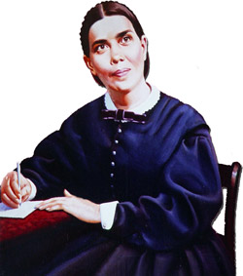
Men and women are in the last hours of probation, and yet are careless and stupid, and ministers have no power to arouse them; they are asleep themselves. Sleeping preachers preaching to a sleeping people!”
Testimonies, Vol. 2 p. 337.

Slide 28
"When the books of Daniel and Revelation are better understood, believers will have an entirely different religious experience. They will be given such glimpses of the open gates of heaven that heart and mind will be impressed with the character that all must develop in order to realize the blessedness which is to be the reward of the pure in heart." -Testimonies to Ministers, p. 114.

Slide 29
Ministers should present the sure word of prophecy as the foundation of the faith of Seventh-day Adventists. The prophecies of Daniel and the Revelation should be carefully studied, and in connection with them the words, "Behold the Lamb of God, which taketh away the sin of the world.”
{Ev 196.2}

Slide 30
There are many precious truths contained in the Word of God, but it is “present truth” that the flock needs now {EW 63.1}

Slide 31
“By the increase of knowledge a people is to be prepared to stand in the latter days. {1MR 43.3}”

Slide 32
If those who have been in the church for weeks and months have not learned the straightness of the way, and what it is to be Christians, and cannot hear all the straight truths of the Word of God, it were better that they were cut off from Israel. It is too late in the day to feed with milk. If souls a month or two old in the truth, who are about to enter the time of trouble such as never was, cannot hear all the straight truth, or endure the strong meat of the straightness of the way, how will they stand in the day of battle? Truths that we have been years learning must be learned in a few months by those who now embrace the Third Angel's Message.
{Ms. 1, 1854,}

Slide 33
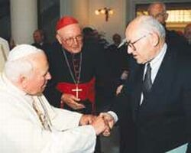
I saw the nominal church and nominal Adventists, like Judas, would betray us to the Catholics to obtain their influence to come against the truth. The saints then will be an obscure people, little known to the Catholics; but the churches and nominal Adventists who know of our faith and customs (for they hated us on account of the Sabbath, for they could not refute it) will betray the saints and report them to the Catholics as those who disregard the institutions of the people; that is, that they keep the Sabbath and disregard Sunday. { SpM 1.5}
Conference leader shakes hands with the papacy

Slide 34
"And thou, Capernaum [Seventh-day Adventists, who have had great light], which art exalted unto heaven [in point of privilege], shalt be brought down to hell: for if the mighty works, which have been done in thee, had been done in Sodom, it would have remained until this day. But I say unto you, That it shall be more tolerable for the land of Sodom IN THE DAY OF JUDGMENT, than for thee." E.G. White, Review and Herald Articles, vol. 3, p. 69, col. 3

Slide 35
The enemy of souls has sought to bring in the supposition that a great reformation was to take place among Seventh-day Adventists, and that this reformation would consist in giving up the doctrines which stand as the pillars of our faith,... and engaging in a process of reorganization. Were this reformation to take place, what would result? The principles of truth that God in His wisdom has given to the remnant church, would be discarded. Our religion would be changed. The fundamental principles that have sustained the work for the last fifty years would be accounted as error. A NEW organization would be established. Books of a new order would be written. …

Slide 36
A system of intellectual philosophy would be introduced. The founders of this system would go into the cities, and do a wonderful work. The Sabbath of course, would be lightly regarded, as also the God who created it. Nothing would be allowed to stand in the way of the new movement. The leaders would teach that virtue is better than vice, but God being removed, they would place their dependence on human power, which, without God, is worthless. Their foundation would be built on the sand, and STORM and tempest would sweep away the structure. {1SM 204.2}

Slide 37
“As the storm approaches, a large class who have professed faith in the third angel's message, but have not been sanctified through obedience to the truth, abandon their position and join the ranks of the opposition. By uniting with the world and partaking of its spirit, they have come to view matters in nearly the same light; and when the test is brought, they are prepared to choose the easy, popular side. Men of talent and pleasing address, who once rejoiced in the truth, employ their powers to deceive and mislead souls. They become the most bitter enemies of their former brethren. When Sabbathkeepers are brought before the courts to answer for their faith, these apostates are the most efficient agents of Satan to misrepresent and accuse them, and by false reports and insinuations to stir up the rulers against them.
{GC 608.2}”

Slide 38
About 1908, with Sr. Mclnterfer (her Secretary and Brother D. E. Robinson (her granddaughter’s husband) present, and myself Sister White told us that a terrible STORM of persecution was coming, like a windstorm that would blow down every standing object. Not one Seventh-day Adventist was to be seen. They, like the disciples, all forsook Christ and fled. All who had sought positions were never seen anymore. After the storm there was a great calm. Then the Seventh-day Adventist’s arose like a flock of sheep, but without shepherds. They all united in earnest prayer to God who answered by helping them choose leaders of their number who had never sought positions. They prayed most earnestly again for God’s Holy Spirit, which was poured upon them, making them fully ready for service. They then unitedly went forth ‘as an army with banners’ fearlessly and fully to give the message to all the world.’ “—Related by W. E. Ross.

