Slide 1
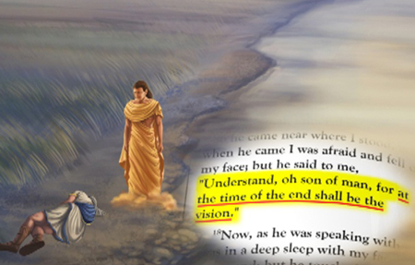
Daniel 8:19
And he said, Behold, I will make thee know what shall be in the last end of the indignation: for at the time appointed the end shall be.

Slide 2
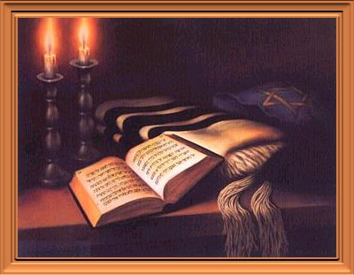
“I am going to let you know what will occur at the final period of the indignation, for it pertains to the appointed time of the end.”
{New American Standard Bible}

Slide 3
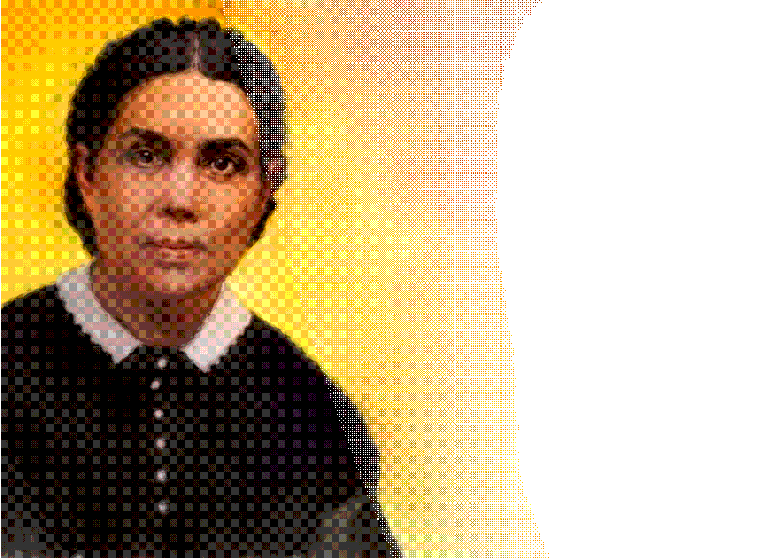
“Historical events, showing the direct fulfillment of prophecy, were set before the people, and the prophecy was seen to be a figurative delineation of events leading down to the close of this earth's history. The scenes connected with the working of the man of sin are the last features plainly revealed in this earth's history”
{2SM. 102}

Slide 4
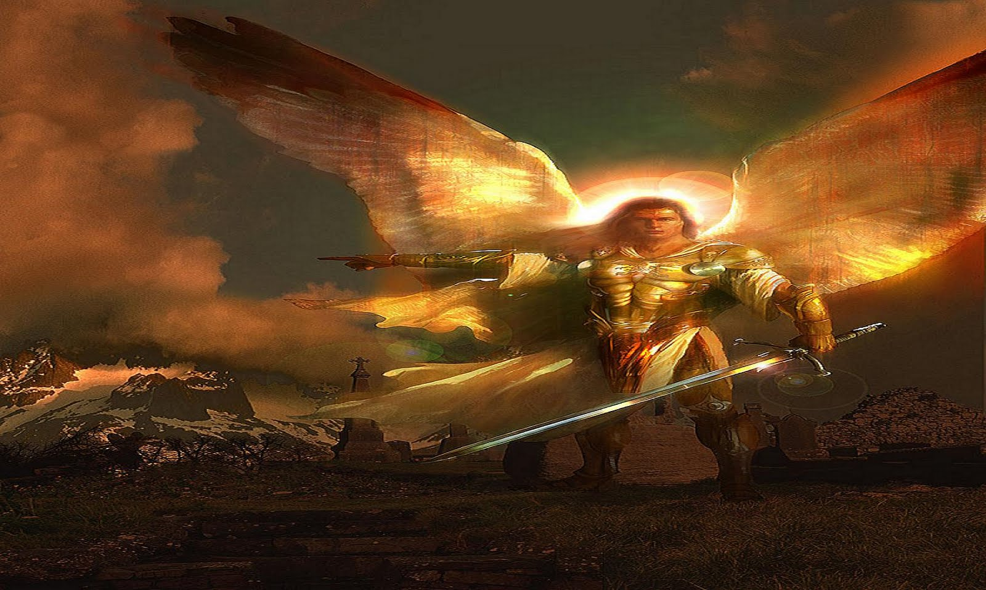
“And at that time shall Michael stand up, the great prince which standeth for the children of thy people: and there shall be a time of trouble, such as never was since there was a nation even to that same time: and at that time thy people shall be delivered, every one that shall be found written in the book.”
Dan 12:1

Slide 5
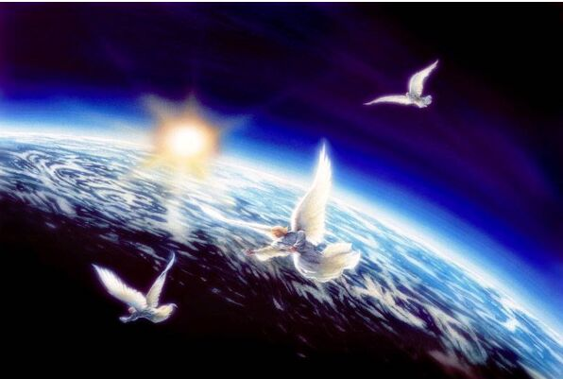
Revelation 14:9-10:
“And the third angel followed them, saying with a loud voice, If any man worship the beast and his image, and receive his mark in his forehead, or in his hand,10The same shall drink of the wine of the wrath of God, which is poured out without mixture into the cup of his indignation; and he shall be tormented with fire and brimstone in the presence of the holy angels, and in the presence of the Lamb:”

Slide 6

Yea, all Israel have transgressed thy law, even by departing, that they might not obey thy voice; therefore the curse is poured upon us, and the oath that is written in the law of Moses the servant of God, because we have sinned against him. ¹²And he hath confirmed his words, which he spake against us, and against our judges that judged us, by bringing upon us a great evil: for under the whole heaven hath not been done as hath been done upon Jerusalem. ¹³As it is written in the law of Moses, all this evil is come upon us: yet made we not our prayer before the LORD our God, that we might turn from our iniquities, and understand thy truth. {Dan 9:11}

Slide 7
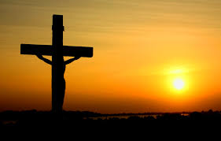
2 Cor 3:18
“But we all, with open face beholding as in a glass the glory of the Lord, are changed into the same image from glory to glory, even as by the Spirit of the Lord”:

Slide 8
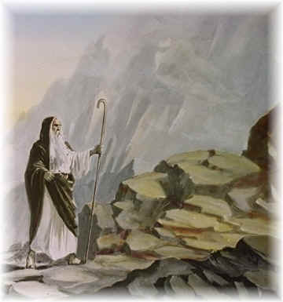
“Patience and gentleness under wrong were not characteristics prized by the heathen or by the Jews. The statement made by Moses under the inspiration of the Holy Spirit, that he was the meekest man upon the earth, would not have been regarded by the people of his time as a commendation; it would rather have excited pity or contempt.” {MB 14:1)

Slide 9
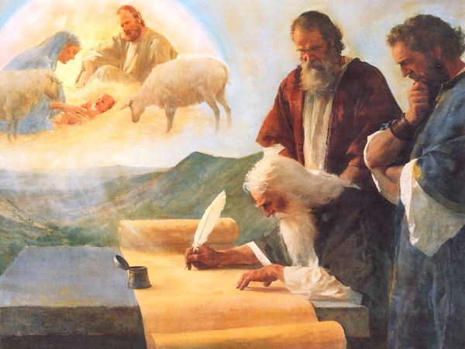
“1Who hath believed our report? and to whom is the arm of the LORD revealed? 2For he shall grow up before him as a tender plant, and as a root out of a dry ground: he hath no form nor comeliness; and when we shall see him, there is no beauty (mareh)that we should desire him. 3He is despised and rejected of men; a man of sorrows, and acquainted with grief: and we hid as it were our faces from him; he was despised, and we esteemed him not.”

Slide 10
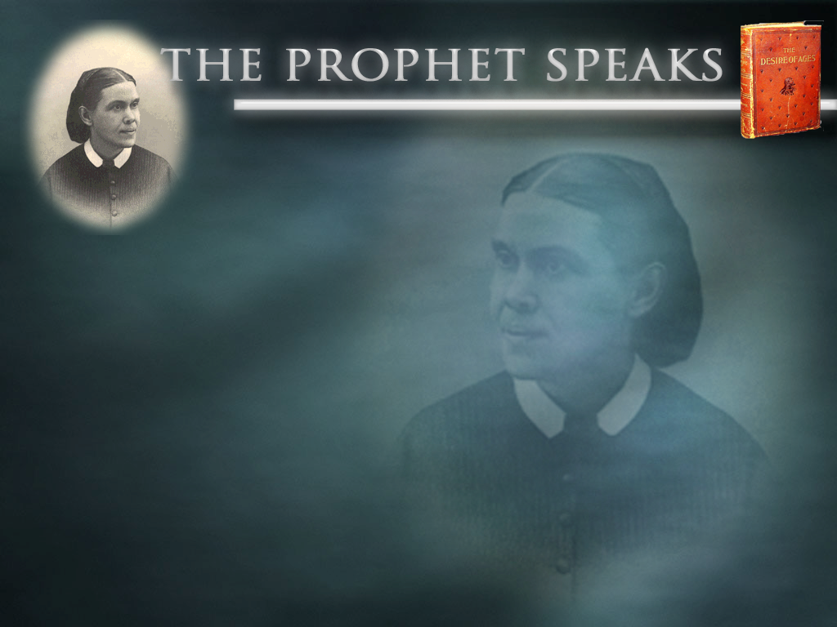
The lessons of Christ, setting forth meekness and humility and love as essential to growth in grace and a fitness for His work, were of the highest value to John. He treasured every lesson and constantly sought to bring his life into harmony with the divine pattern. John had begun to discern the glory of Christ--not the worldly pomp and power for which he had been taught to hope, but "the glory as of the Only Begotten of the Father, full of grace and truth." John 1:14. {AA 544.1} The depth and fervor of John's affection for his Master was not the cause of Christ's love for him, but the effect of that love. John desired to become like Jesus, and under the transforming influence of the love of Christ he did become meek and lowly. Self was hid in Jesus. Above all his companions, John yielded himself to the power of that wondrous life. He says, "The life was manifested, and we have seen it." "And of His fullness have all we received, and grace for grace." 1 John 1:2; John 1:16

Slide 11
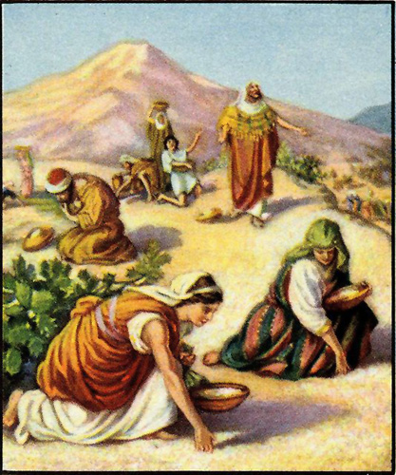
Psalm 78; ²³Though he had commanded the clouds from above, and opened the doors of heaven, ²⁴And had rained down manna upon them to eat, and had given them of the corn of heaven. ²⁵Man did eat angels' food: he sent them meat to the full.

Slide 12
John 6: 56
“He that eateth my flesh, and drinketh my blood, dwelleth in me, and I in him.”

Slide 13
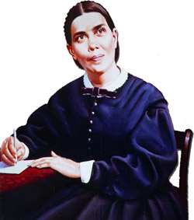
“Thousands were led to embrace the truth preached by William Miller, and servants of God were raised up in the spirit and power of Elijah to proclaim the message. Like John, the forerunner of Jesus, those who preached this solemn message felt compelled to lay the ax at the root of the tree, and call upon men to bring forth fruits meet for repentance. Their testimony was calculated to arouse and powerfully affect the churches and manifest their real character.” EW 233

Slide 14
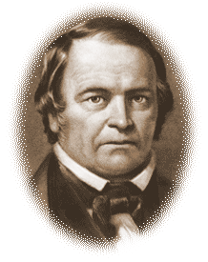
“It passed and the next day it seemed as though all the demons from the bottomless pit were let loose upon us. the same ones and many more who were crying for mercy two days before were now mixed with the rabble and mocking, scoffing and threatening in a most blasphemous manner,
{Words of William miller in a letter dated Dec 13 1844}

Slide 15
The message of Christ's righteousness is to sound from one end of the earth to the other to prepare the way of the Lord. This is the glory of God, which closes the work of the third angel.--6T 19 (1900). {LDE 200.3} The last message of mercy to be given to the world is a revelation of His character of love. The children of God are to manifest His glory. In their own life and character they are to reveal what the grace of God has done for them.--COL 415, 416 (1900). {LDE 200.4}

Slide 16
Several have written to me, inquiring if the message of justification by faith is the third angel's message, and I have answered, "It is the third angel's message in verity." The prophet declares, "And after these things I saw another angel come down from heaven, having great power; and the earth was lightened with his glory. {RH APRIL 1 1890}
What is justification by faith? It is the work of God in laying the glory of man in the dust, and doing for man that which it is not in his power to do for himself. When men see their own nothingness, they are prepared to be clothed with the righteousness of Christ. {FLB 111.2}

Slide 17
Christ's indignation was directed against the hypocrisy, the gross sins, by which men were destroying their own souls, deceiving the people and dishonoring God. In the specious deceptive reasoning of the priests and rulers He discerned the working of satanic agencies. Keen and searching had been His denunciation of sin; but He spoke no words of retaliation. He had a holy wrath against the prince of darkness; but He manifested no irritated temper. So the Christian who lives in harmony with God, possessing the sweet attributes of love and mercy, will feel a righteous indignation against sin; but he will not be roused by passion to revile those who revile him. Even in meeting those who are moved by a power from beneath to maintain falsehood, in Christ he will still preserve calmness and self-possession. {DA 619.5}

