Slide 1
The Mareh
Daniel 8:26:
‘Make this man understand the vision (mareh), for is shall be for the latter days”

Slide 2
Daniel 8:26:
‘Make this man understand the vision (mareh), for is shall be for the latter days”.

Slide 3
“In the third year of the reign of king Belshazzar a vision appeared unto me, even unto me Daniel, after that which appeared unto me at the first.” Daniel 8:1”

Slide 4
“¹³Then I heard one saint speaking, and another saint said unto that certain saint which spake, How long shall be the vision concerning the daily sacrifice, and the transgression of desolation, to give both the sanctuary and the host to be trodden under foot? ¹⁴And he said unto me, Unto two thousand and three hundred days; then shall the sanctuary be cleansed.
And it came to pass, when I, even I Daniel, had seen the vision {Chazon}, and sought for the meaning, then, behold, there stood before me as the appearance {Mareh} of a man.” 16And I heard a man's voice between the banks of Ulai, which called, and said, Gabriel, make this man to understand the vision {mareh}. 17So he came near where I stood: and when he came, I was afraid, and fell upon my face: but he said unto me, Understand, O son of man: for at the time of the end shall be the vision. {Chazon}
{Daniel 8:13-17}

Slide 5
Now as he was speaking with me, I was in a deep sleep on my face toward the ground: but he touched me, and set me upright.
¹⁹ And he said, Behold, I will make thee know what shall be in the last end of the indignation: for at the time appointed the end shall be. {Daniel 8:18-19}

Slide 6
“I am going to let you know what will occur at the final period of the indignation, for it pertains to the appointed time of the end.”
{New American Standard Bible}

Slide 7
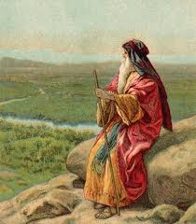
Deut 29:
²⁷And the anger of the LORD was kindled against this land, to bring upon it all the curses that are written in this book:
²⁸And the LORD rooted them out of their land in anger, and in wrath, and in great indignation, and cast them into another land, as it is this day.

Slide 9
Daniel 12:4: “But thou, O Daniel, shut up the words, and seal the book, even to the time of the end: many shall run to and fro, and knowledge shall be increased.”
5Then I Daniel looked, and, behold, there stood other two, the one on this side of the bank of the river, and the other on that side of the bank of the river. “6And one said to the man clothed in linen, which was upon the waters of the river, How long shall it be to the end of these wonders? 7And I heard the man clothed in linen, which was upon the waters of the river, when he held up his right hand and his left hand unto heaven, and sware by him that liveth for ever that it shall be for a time, times, and an half; and when he shall have accomplished to scatter the power of the holy people, all these things shall be finished. 8And I heard, but I understood not: then said I, O my Lord, what shall be the end of these things? 9And he said, Go thy way, Daniel: for the words are closed up and sealed till the time of the end.

Slide 10
Daniel 8:27:
“And I Daniel fainted, and was sick certain days; afterward I rose up, and did the king's business; and I was astonished at the vision (MAREH), but none understood it.”

Slide 11
Daniel 9:“. 22And he informed me, and talked with me, and said, O Daniel, I am now come forth to give thee skill and understanding. 23At the beginning of thy supplications the commandment came forth, and I am come to shew thee; for thou art greatly beloved: therefore understand the matter, and consider the vision (MAREH).”

Slide 12
1cor 3:11, “For other foundation can no man lay than that is laid, which is Jesus Christ.”

Slide 13
In the mount, when the law was given to Moses, the Coming One was shown to him also. He saw Christ's work, and His mission to earth, when the Son of God should take upon Himself humanity, and become a teacher and a guide to the world, and at last give Himself a ransom for their sins. When the perfect Offering should be made for the sins of men, the sacrificial offerings typifying the work of the Messiah were to cease. With the advent of Christ, the veil of uncertainty was to be lifted, and a flood of light shed upon the darkened understanding of His people. {1BC 1110.1}

Slide 14
As Moses saw the day of Christ, and the new and living way of salvation that was to be opened through His blood, he was captivated and entranced. The praise of God was in his heart, and the divine glory that attended the giving of the law was so strikingly revealed in his countenance when he came down from the mount to walk with Israel, that the brightness was painful. Because of their transgressions, the people were unable to look upon his face, and he wore a veil that he might not terrify them. . . . {1BC 1110.2}

Slide 15
“True holiness and humility are inseparable. The nearer the soul comes to God, the more completely is it humbled and subdued. When Job heard the voice of the Lord out of the whirlwind, he exclaimed, "I abhor myself, and repent in dust and ashes" (Job 42:6). It was when Isaiah saw the glory of the Lord and heard the cherubim crying, "Holy, holy, holy, is the Lord of hosts," that he cried out, "Woe is me! for I am undone" (Isaiah 6:3, 5). Daniel, when visited by the holy messenger, says, "My comeliness was turned in me into corruption" (Daniel 10:8). Paul, after he was caught up into the third heaven and heard things that it was not lawful for a man to utter, speaks of himself as "less than the least of all saints" (Ephesians 3:8). It was the beloved John, who leaned on Jesus' breast and beheld His glory, who fell as one dead before the angel. The more closely and continuously we behold our Saviour, the less shall we see to approve in ourselves. {TMK 175.3}

Slide 16
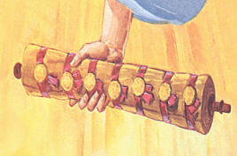
“"And I saw in the right hand of Him that sat on the throne a book written within and on the backside, sealed with seven seals. (Revelation 5:1-3 quoted). There in His open hand lay the book, the roll of the history of God's providences, the prophetic history of nations and the church. Herein was contained the divine utterances, His authority, His commandments, His laws, the whole symbolic counsel of the Eternal, and the history of all ruling powers in the nations. In symbolic language was contained in that roll the influence of every nation, tongue, and people from the beginning of earth's history to its close. This roll was written within and without. John says: [Revelation 5:4, 5, 8-14; 6:8-11; 8:1-4; quoted.” {MR 667}

Slide 17
And I saw another mighty angel come down from heaven, clothed with a cloud: and a rainbow was upon his head, and his face was as it were the sun, and his feet as pillars of fire: And he had in his hand a little book open: and he set his right foot upon the sea, and his left foot on the earth,
And cried with a loud voice, as when a lion roareth: and when he had cried, seven thunders uttered their voices
{Revelation 10:1-3)

Slide 18
“The comprehension of truth, the glad reception of the message, is represented in the eating of the little book. The truth in regard to the time of the advent of our Lord was a precious message to our souls.—Manuscript 59, 1900 (Manuscript Releases, vol. 19, pp. 319-321). {CTr 344.6}

Slide 19
“And he said unto me, Son of man, cause thy belly to eat, and fill thy bowels with this roll that I give thee. Then did I eat it; and it was in my mouth as honey for sweetness. And he said unto me, Son of man, go, get thee unto the house of Israel, and speak with my words unto them” {Ezekiel 3:3-4}

Slide 20
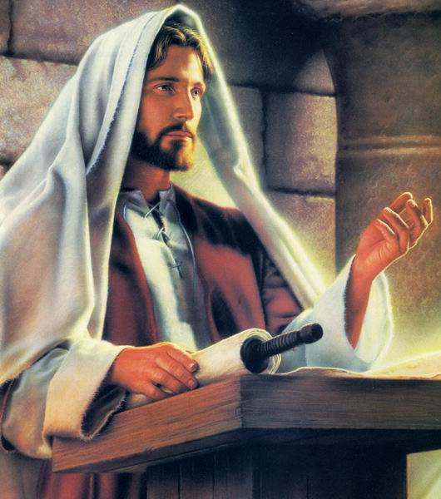
John 6:
“53Then Jesus said unto them, Verily, verily, I say unto you, Except ye eat the flesh of the Son of man, and drink his blood, ye have no life in you. 54Whoso eateth my flesh, and drinketh my blood, hath eternal life; and I will raise him up at the last day. 55For my flesh is meat indeed, and my blood is drink indeed. 56He that eateth my flesh, and drinketh my blood, dwelleth in me, and I in him. 57As the living Father hath sent me, and I live by the Father: so he that eateth me, even he shall live by me. 58This is that bread which came down from heaven: not as your fathers did eat manna, and are dead: he that eateth of this bread shall live for ever.”

Slide 21
John 6: 63 It is the spirit that quickeneth; the flesh profiteth nothing: the words that I speak unto you, they are spirit, and they are life.”

Slide 22
In our daily lives, before our brethren and before the world, we are to be living interpreters of the Scriptures, doing honor to Christ by revealing His meekness and His lowliness of heart. As we eat and digest the bread of life, we shall reveal a symmetrical character. By our unity, by esteeming others better than ourselves, we are to bear to the world a living testimony of the power of the truth. . . . {LHU 105.6}
When men submit entirely to God, eating the bread of life and drinking the water of salvation, they will grow up into Christ. Their characters are composed of that which the mind eats and drinks. Through the Word of life, which they receive and obey, they become partakers of the divine nature. Then . . . Christ, not man, is exalted (The SDA Bible Commentary, Ellen G. White Comments, vol. 5, p. 1135).

Slide 23
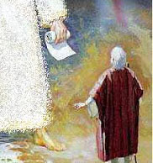
After these seven thunders uttered their voices, the instruction comes to John, as to Daniel, in regard to the little book: “Seal up those things which the seven thunders uttered.”. . . John sees the little book unsealed. . . . Then Daniel’s prophecies have their proper place in the first, second, and third angels’ messages to be given to the world. The unsealing of the little book was the message in relation to time. {CTr 344.3}

Slide 24
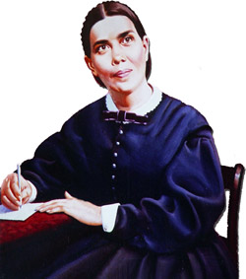
“The book that was sealed was not the book of Revelation, but that portion of the prophecy of Daniel which related to the last days. The Scripture says, "But thou, O Daniel, shut up the words, and seal the book, even to the time of the end: many shall run to and fro, and knowledge shall be increased" (Daniel 12:4). When the book was opened, the proclamation was made, "Time shall be no longer." ." (See Revelation 10:6.) The book of Daniel is now unsealed, and the revelation made by Christ to John is to come to all the inhabitants of the earth. By the increase of knowledge a people is to be prepared to stand in the latter days. {2SM 105.1}

Slide 25
The prophecies of Daniel and of John are to be understood. They interpret each other. They give to the world truths which every one should understand. These prophecies are to be witnesses in the world. By their fulfillment in these last days they will explain themselves. {7BC 949.6}

Slide 26
Let us give more time to the study of the Bible. We do not understand the Word as we should. The book of Revelation opens with an injunction to us to understand the instruction that it contains. . . . When we . . . understand what this book means to us, there will be seen among us a great revival. {flb 345}

Slide 27
“when the book of Daniel and Revelation are better understood, believers will have an entirely different religious experience. They will be given such glimpses of the open gates of heaven that heart and mind will be impressed with the character that all must develop in order to realize the blessedness which is to be the reward of the pure in heart. {TM 114.3}

Slide 28
Daniel was a man to whom God had given great skill and learning, and when he fasted the angel came to him and said, "Thou art greatly beloved." And he fell prostrate before the angel. He did not say, "Lord, I have been very faithful to You and I have done everything to honor You and defend Your word and name. Lord, You know how faithful I was at the king's table, and how I maintained my integrity when they cast me into the den of lions." Was that the way Daniel prayed to God? {3SM 353.3} No; he prayed and confessed his sins, and said, Hear O Lord, and deliver; we have departed from Thy Word and have sinned. And when he saw the angel, he said, My comeliness was turned into corruption. He could not look upon the angel's face, and he had no strength; it was all gone. So the angel came to him and set him upon his knees. He could not behold him then. And then the angel came to him with the appearance of a man. Then he could bear the sight. {3SM 354.1}

