Slide 1
“Rejoice in the LORD, O ye righteous: for praise is comely for the upright. Praise the LORD with harp: sing unto him with the psaltery and an instrument of ten strings. Sing unto him a new song; play skilfully with a loud noise.” Psalm 33:1-3

Slide 2
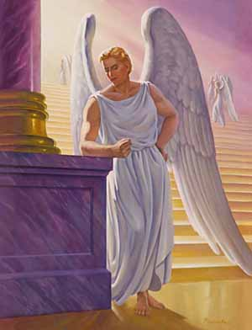
Thou hast been in Eden the garden of God; every precious stone was thy covering, the sardius, topaz, and the diamond, the beryl, the onyx, and the jasper, the sapphire, the emerald, and the carbuncle, and gold: the workmanship of thy tabrets and of thy pipes was prepared in thee in the day that thou wast created. {Eze 28:13}

Slide 3
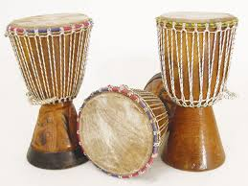
“The Hebrew word pronounced tofe is variously translated as either tabret, timbrel or tambourine - the King James Version uses both tabret and timbrel. The English "tabret" is derived from an Old French and Spanish word, tabor (or tabour), which was a small hand-held drum, often highly-ornamented, beaten with a single stick, and usually played in accompaniment to one or more of singing and string or wind instruments.”

Slide 4
Thou art the anointed cherub that covereth; and I have set thee so: thou wast upon the holy mountain of God; thou hast walked up and down in the midst of the stones of fire.
Thou wast perfect in thy ways from the day that thou wast created, till iniquity was found in thee. {Eze 28:14-15}

Slide 5
9And the third angel followed them, saying with a loud voice, If any man worship the beast and his image, and receive his mark in his forehead, or in his hand, 10The same shall drink of the wine of the wrath of God, which is poured out without mixture into the cup of his indignation; and he shall be tormented with fire and brimstone in the presence of the holy angels, and in the presence of the Lamb:
{Revelation 14}

Slide 6
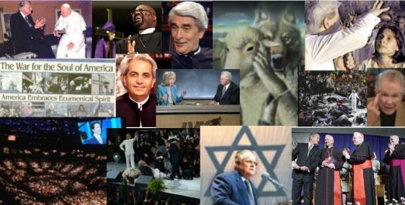
14And deceiveth them that dwell on the earth by the means of those miracles which he had power to do in the sight of the beast; saying to them that dwell on the earth, that they should make an image to the beast, which had the wound by a sword, and did live. 15And he had power to give life unto the image of the beast, that the image of the beast should both speak, and cause that as many as would not worship the image of the beast should be killed.
{Revelation 13}

Slide 7
And the beast was taken, and with him the false prophet that wrought miracles before him, with which he deceived them that had received the mark of the beast, and them that worshipped his image. These both were cast alive into a lake of fire burning with brimstone. {Rev 19:20}

Slide 8
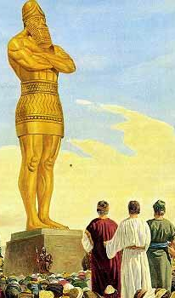
1Nebuchadnezzar the king made an image of gold, whose height was threescore cubits, and the breadth thereof six cubits: he set it up in the plain of Dura, in the province of Babylon. 2Then Nebuchadnezzar the king sent to gather together the princes, the governors, and the captains, the judges, the treasurers, the counsellers, the sheriffs, and all the rulers of the provinces, to come to the dedication of the image which Nebuchadnezzar the king had set up. 3Then the princes, the governors, and captains, the judges, the treasurers, the counsellers, the sheriffs, and all the rulers of the provinces, were gathered together unto the dedication of the image that Nebuchadnezzar the king had set up; and they stood before the image that Nebuchadnezzar had set up.

Slide 9
. 4Then an herald cried aloud, To you it is commanded, O people, nations, and languages, 5That at what time ye hear the sound of the cornet, flute, harp, sackbut, psaltery, dulcimer, and all kinds of musick, ye fall down and worship the golden image that Nebuchadnezzar the king hath set up: 6And whoso falleth not down and worshippeth shall the same hour be cast into the midst of a burning fiery furnace. 7Therefore at that time, when all the people heard the sound of the cornet, flute, harp, sackbut, psaltery, and all kinds of musick, all the people, the nations, and the languages, fell down and worshipped the golden image that Nebuchadnezzar the king had set up.

Slide 10
8Wherefore at that time certain Chaldeans came near, and accused the Jews. 9They spake and said to the king Nebuchadnezzar, O king, live for ever. 10Thou, O king, hast made a decree, that every man that shall hear the sound of the cornet, flute, harp, sackbut, psaltery, and dulcimer, and all kinds of musick, shall fall down and worship the golden image: 11And whoso falleth not down and worshippeth, that he should be cast into the midst of a burning fiery furnace. 12There are certain Jews whom thou hast set over the affairs of the province of Babylon, Shadrach, Meshach, and Abednego; these men, O king, have not regarded thee: they serve not thy gods, nor worship the golden image which thou hast set up.

Slide 11
1 Cor 10:
6Now these things were our examples, to the intent we should not lust after evil things, as they also lusted. 7Neither be ye idolaters, as were some of them; (other Israelites worshipped image) as it is written, The people sat down to eat and drink, and rose up to play. 8Neither let us commit fornication, as some of them committed, and fell in one day three and twenty thousand.”

Slide 12
Balaam and Balak

Slide 13
“At first there was little intercourse between the Israelites] and their heathen neighbors, but after a time Midianitish women began to steal into the camp [the books of a new order, music, ecumenism]. Their appearance excited no alarm, and so quietly were their plans con-ducted that the attention of Moses was not called to the matter. It was the object of these women, in their associa-tion with the Hebrews, to seduce them into transgression of the law of God, to draw their attention to heathen rites and customs, and lead them. These motives were studiously concealed under the garb of friendship, so that they were not suspected, even by the guardians of the people.

Slide 14
At Balaam's suggestion, a grand festival in honor of their gods was appointed by the king of Moab, and it was secretly arranged that Balaam should induce the Israelites to attend. He [the pastors] was regarded by them as a prophet of God, and hence had little difficulty in accomplishing his purpose. Great numbers of the people joined him in witnessing the festivities. They ventured upon the forbidden ground, and were entangled in the snare of Satan. Beguiled with music and dancing, and allured by the beauty of heathen vestals, they cast off their fealty to Jehovah. As they united in mirth and feasting, indulgence in wine beclouded their senses and broke down the barriers of self-control. Passion had full sway; and having defiled their consciences by lewdness, they were persuaded to bow down to idols. They offered sacrifice upon heathen altars and participated in the most degrading rites.” {Patriarchs and Prophets 454.3}

Slide 15
“Israel abode in Shittim, and the people began to commit whoredom with the daughters of Moab [fallen churches]. And they called the people unto the sacrifices of their gods: and the people did eat, and bowed down to their gods [today they are doing this through the ecumenical movement]. And Israel joined himself unto Baalpeor" Numbers 25:1-3. It was not long before the poison had spread, like a deadly infection, through the camp of Israel. Those who would have conquered their enemies in battle were overcome by the wiles of heathen women [in our time it will be the fallen churches]. The people seemed to be infatuated. The rulers and the leading men were among the first to transgress, and so many of the people were guilty that the apostasy became national. “Israel joined himself unto Baalpeor."“…

Slide 16
“…A terrible pestilence broke out in the camp, to which tens of thousands speedily fell a prey. God commanded that the leaders in this apostasy be put to death by the magistrates. This order was promptly obeyed. The offenders were slain, then their bodies were hung up in sight of all Israel that the congregation, seeing the leaders so severely dealt with, might have a deep sense of God's abhorrence of their sin and the terror of His wrath against them. …Zimri, one of the nobles of Israel, came boldly into the camp, accompanied by a Midianitish harlot, a princess "of a chief house in Midian," whom he escorted to his tent.
Never was vice bolder or more stubborn. Inflamed with wine [in our case, it will be false doctrine, for in bible prophecy wine represents teaching], Zimri declared his "sin as Sodom," and gloried in his shame… flaunted his sin in the sight of the congregation, as if to defy the vengeance of God and mock the judges of the nation. Phinehas, the son of Eleazar the high priest, rose up from among the congregation, and seizing a javelin "he went after the man of Israel into the tent," and slew them both” {Patriachs and Prophets 455}.

Slide 17
“On Wednesday April 17, 21 Seventh-day Adventist pastors joined four hundred Anglicans, Pentecostals, Salvation Army, Methodists and other denominations for an "Adventures in Evangelism" seminar sponsored by the Willow Creek Association, Chicago, USA . The main speakers, Lee Strobel and Mark Mittelberg are leaders in the organisation that has become famous in Christian circles around the world, for its "Seeker Services" and reaching the secular mind…….. Whatever the views of the participating Adventist pastors, two things can be said about the seminar: it was very well organised, and Willow Creek have a clear vision for meaningful and relevant contemporary evangelism. Certainly the day offered useful pointers and stimulated the mind to evaluate our own evangelistic methods and styles” (Entered from Dalbert Elias delias@adventist.org.uk in BUC news April 24, 1999) http://www.tagnet.org/adventist.fm/lnews.htm lnews.html

Slide 18
“The Seventh-day Adventist Church stepped upon the stage of history-so Adventists firmly believe-in response to God's call. Adventists believe, it is hoped without pride or arrogance, that the Advent Movement represents the divinely appointed instrument for the organized proclamation of the "eternal gospel," God's last message, discerned from the prophetic vantage point of Revelation 14 and 18. In the focalized light of its prophetic understanding, the Seventh-day Adventist Church sees herself as the eschatologically oriented "ecumenical" movement of the Apocalypse. She begins by "calling out" God's children from "fallen" ecclesial bodies that will increasingly form organized religious opposition to the purposes of God. Together with the "calling out" there is a positive "calling in" to a united, worldwide-that is, ecumenical-movement characterized by "faith of Jesus" and keeping "the commandments of God" (Rev. 14:12). In the World Council of Churches the emphasis is first of all on "coming in" to a fellowship of churches and then hopefully and gradually "coming out" of corporate disunity. In the Advent Movement the accent is first on "coming out" of Babylonian disunity and confusion and then immediately "coming in" to a fellowship of unity, truth, and love within the globe-encircling Advent family. {Quote taken from: http://www.adventist.org/beliefs/other_documents/other_doc3.html}

Slide 19
“Israel [Adventism] abode in Shittim, and the people began to commit whoredom [join with false worshippers] with the daughters of Moab [fallen churches, false prophet]. And they called the people unto the sacrifices of their gods: and the people did eat, and bowed down to their gods [today they are doing this through the ecumenical movement]. And Israel joined himself unto Baalpeor" Numbers 25:1-3. It was not long before the poison had spread, like a deadly infection, through the camp of Israel. Those who would have conquered their enemies in battle were overcome by the wiles of heathen women [in our time it will be the fallen churches]. The people seemed to be infatuated. The rulers and the leading men were among the first to transgress, and so many of the people were guilty that the apostasy became national. “Israel joined himself unto Baalpeor."“…A terrible pestilence broke out in the camp, to which tens of thousands speedily fell a prey. God commanded that the leaders in this apostasy be put to death by the magistrates. This order was promptly obeyed. The offenders were slain, then their bodies were hung up in sight of all Israel that the congregation, seeing the leaders so severely dealt with, might have a deep sense of God's abhorrence of their sin and the terror of His wrath against them.
{Patriachs and Prophets 455}

Slide 20
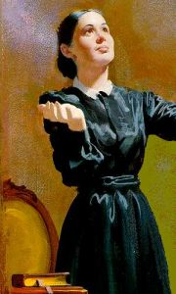
The things you have described as taking place in Indiana, the Lord has shown me would take place just before the close of probation. Every uncouth thing will be demonstrated. There will be shouting, with drums, music, and dancing.
The senses of rational beings will become so confused that they cannot be trusted to make right decisions. And this is called the moving of the Holy Spirit
The Holy Spirit never reveals itself in such methods, in such a bedlam of noise. This is an invention of Satan to cover up his ingenious methods for making of none effect the pure, sincere, elevating, ennobling, sanctifying truth for this time.

Slide 21
Better never have the worship of God blended with music than to use musical instruments to do the work which last January was represented to me would be brought into our camp meetings. The truth for this time needs nothing of this kind in its work of converting souls. A bedlam of noise shocks the senses and perverts that which if conducted aright might be a blessing. The powers of satanic agencies blend with the din and noise, to have a carnival, and this is termed the Holy Spirit's working. . . .
{Voice in Speech and Song 417.}

Slide 22
Satan's Snare--The Holy Spirit has nothing to do with such a confusion of noise and multitude of sounds as passed before me last January. Satan works amid the din and confusion of such music, which, properly conducted, would be a praise and glory to God. He makes its effect like the poison sting of the serpent. {VSS 418.2}
Those things which have been in the past will be in the future. Satan will make music a snare by the way in which it is conducted.--2SM 37, 38. {VSS 418.3}

Slide 23
Just before the close of probation…
http://www.christiancentury.org/article/2014-09/us-churches-feel-beat-change-more-diversity-more-drums
More drums, fewer choirs in worship, national study of congregations shows
Sep 12, 2014 by Cathy Lynn Grossman
U.S. religious congregations are marching to their own drums now more than ever.
More congregations have drums in worship—along with hand waving, amen shouting, and dancing in the aisles—according to one of the findings of the latest National Congregations Study.

Slide 24
I feel alarmed as I witness everywhere the frivolity of young men and young women who profess to believe the truth. God does not seem to be in their thoughts. Their minds are filled with nonsense. Their conversation is only empty, vain talk. They have a keen ear for music, and Satan knows what organs to excite to animate, engross, and charm the mind so that Christ is not desired. The spiritual longings of the soul for divine knowledge, for a growth in grace, are wanting. {VSS 419.1} I was shown that the youth must take a higher stand and make the Word of God the man of their counsel and their guide. Solemn responsibilities rest upon the young, which they lightly regard. The introduction of music into their homes, instead of inciting to holiness and spirituality, has been the means of diverting their minds from the truth. Frivolous songs and the popular sheet music of the day seem congenial to their taste. The instruments of music have taken time which should have been devoted to prayer.

Slide 25
Play video

Slide 26
Frontal Lobe
Limbic System (Emotional Brain)
Sub Conscious Mind

Slide 27
There are some people when they hear sound of a drums, they cannot stand still, their whole body starts to move and in a few seconds they begging to dance to the drum. Because the person spirit and the drummer and drum spirit comes together as one spirit, and that person is also have a very high spiritual communication with drum and the drummer, which any drummer or musician will love to when he/she is giving a concert to see people dancing to your music, it is lick the person is telling the drummer that he/she understand the spiritual drum language. So those kinds of people know how to use their spirit, because drums rhythm is an international language, in any culture or traditions they have drum rhythm in their society.
http://www.african-drumming.com/african_drums.htm

Slide 28
Fanaticism, false excitement, false talking in tongues, and noisy exercises have been considered gifts which God has placed in the church. Some have been deceived here. The fruits of all this have not been good. "Ye shall know them by their fruits." Fanaticism and noise have been considered special evidences of faith. Some are not satisfied with a meeting unless they have a powerful and happy time. They work for this and get up an excitement of feeling. But the influence of such meetings is not beneficial. When the happy flight of feeling is gone they sink lower than before the meeting because their happiness did not come from the right source. {LDE 159.4}
The most profitable meetings for spiritual advancement are those which are characterized with solemnity and deep searching of heart, each seeking to know himself and, earnestly and in deep humility, seeking to learn of Christ.--1T 412 (1864). {LDE 160.1}

Slide 29
Music, when not abused, is a great blessing; but when put to a wrong use, it is a terrible curse. It excites, but does not impart that strength and courage which the Christian can find only at the throne of grace while humbly making known his wants and with strong cries and tears pleading for heavenly strength to be fortified against the powerful temptations of the evil one. Satan is leading the young captive. Oh, what can I say to lead them to break his power of infatuation! He is a skillful charmer, luring them on to perdition. --1T 496, 497. {VSS 420.1}
Music has occupied the hours which should have been devoted to prayer. Music is the idol which many professed Sabbathkeeping Christians worship. Satan has no objection to music if he can make that a channel through which to gain access to the minds of the youth. {VSS 420.3}

Slide 30
“For the leaders of this people cause them to err; and they that are led of them are destroyed” (Isaiah 9:16).

Slide 31
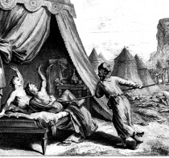
“And, behold, one of the children of Israel came and brought unto his brethren a Midianitish woman in the sight of Moses, and in the sight of all the congregation of the children of Israel, who [were] weeping [before] the door of the tabernacle of the congregation. And he went af-ter the man of Israel into the tent, and thrust both of them through, the man of Israel, and the woman through her belly. So the plague was stayed from the children of Israel.” Numbers 25:1-8.

Slide 32
“Howbeit that was not first which is spiritual, but that which is natural; and afterward that which is spiritual.” (1Cor. 15: 46).“

Slide 33
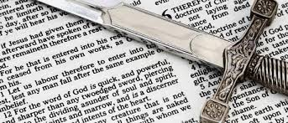
“For we wrestle not against flesh and blood, but against principalities, against powers, against the rulers of the darkness of this world, against spiritual wickedness in high places. Wherefore take unto you the whole armour of God, that ye may be able to withstand in the evil day, and having done all, to stand… And take the helmet of salvation, and the sword of the Spirit, which is the word of God” (Eph. 6:12-17).

Slide 34
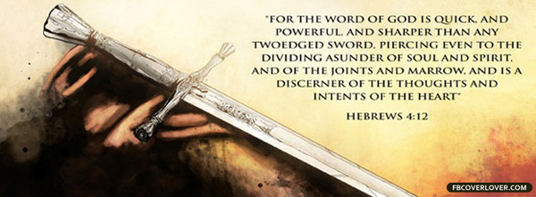

Slide 35
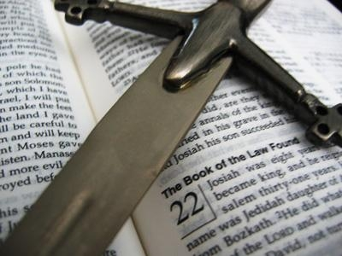
Hosea 6:5
“Therefore have I hewed them by the prophets; I have slain them by the words of my mouth: and thy judgments are as light that goeth forth.”

