Slide 1
The Day of the East Wind

Slide 2
“Each of the ancient prophets spoke less for their own time than for ours, so that their prophesying is in force for us.”
{3Selected Messages 338.1}

Slide 3
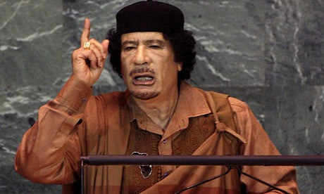
"If we decide to, we are able to move to Europe like LOCUSTS, like bees. We advise you to retreat before you are dealt a disaster," Gaddafi

Slide 4
Symbol of Islam
The star and crescent is the best-known symbol used to represent Islam. It features prominently on the flags of many countries in the Islamic world, notably Turkey and Pakistan.
Surprisingly, the symbol is not Muslim in origin. Rather, it was a polytheistic icon adopted during the spread of Islam, and its use today is sometimes controversial in the Muslim world. The crescent and star are often said to be Islamic symbols, but historians say that they were the insignia of the Ottoman Empire, not of Islam as a whole.
{http://www.religionfacts.com/islam/symbols.htm}

Slide 5
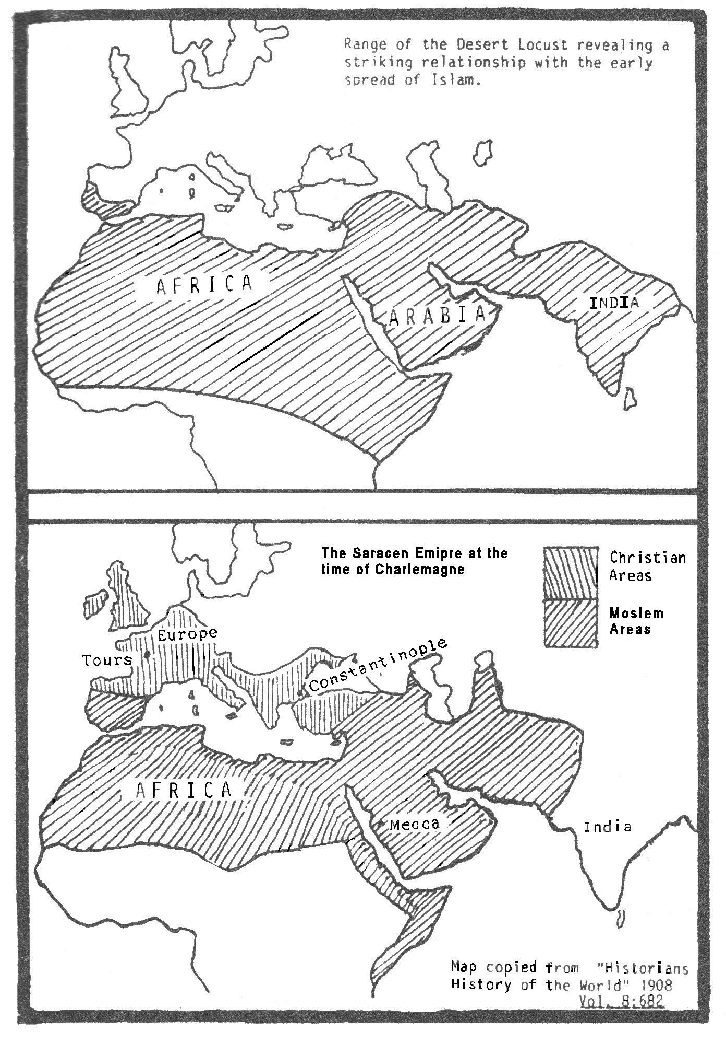
Notice the statement by Forster, concerning the Arabs.
"In the Bedoween Romance of Antar the locust is introduced as the national emblem of the Ishmaelites." 'Mahommedanism Unveiled.'- Vol. 1. 217.
Edward Gibbon quoting Volney, "the most judicious of our Syrian travelers" declared,
"The inhabitants of Syria have remarked that locusts come constantly from the desert of Arabia.".
{C. Volney "Voyage en Egypte et en Syrie!' Chap.XX Sect. 5}

Slide 6
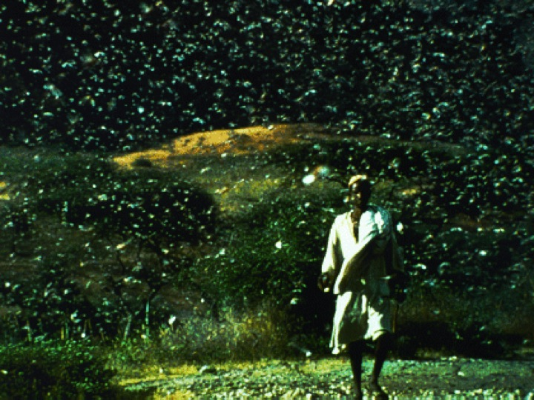

Slide 7
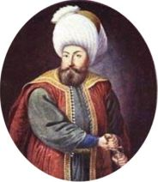
Rise of the Ottoman Empire
When did the 150 years start?
According to Edward Gibbon –
“Othman first entered the territory of Nicomedia on the 27th July 1299.”
Started to attack Eastern Rome.
Finished in 1449. (1299+150 = 1449)

Slide 8
An Hour, a Day, a Month, and a Year.
One Hour = 1/24 of a day = 1/24 of a year
Or 1/24 of 360 days = 15 solar days
One Day = 1 Bible day = 1 Solar Year
One Month = 30 Bible days = 30 solar Years
One Year = 360 Bible days = 360 solar Years
TOTAL = 391 Years, 15 days

Slide 9
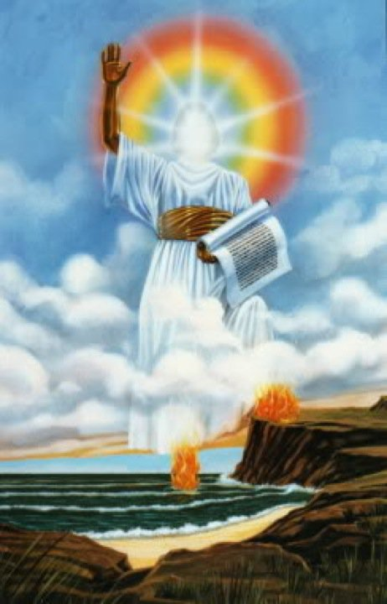
“In the year 1840 another remarkable fulfillment of prophecy excited widespread interest. Two years before, Josiah Litch, one of the leading ministers preaching the second advent, published an exposition of Revelation 9, predicting the fall of the Ottoman Empire. According to his calculations, this power was to be overthrown "in A.D. 1840, sometime in the month of August;" and only a few days previous to its accomplishment he wrote: "Allowing the first period, 150 years, to have been exactly fulfilled before Deacozes ascended the throne by permission of the Turks, and that the 391 years, fifteen days, commenced at the close of the first period, it will end on the 11th of August, 1840, when the Ottoman power in Constantinople may be expected to be broken. And this, I believe, will be found to be the case."--Josiah Litch, in Signs of the Times, and Expositor of Prophecy, Aug. 1, 1840. At the very time specified, Turkey, through her ambassadors, accepted the protection of the allied powers of Europe, and thus placed herself under the control of Christian nations. The event exactly fulfilled the prediction. When it became known, multitudes were convinced of the correctness of the principles of prophetic interpretation adopted by Miller and his associates, and a wonderful impetus was given to the advent movement. Men of learning and position united with Miller, both in preaching and in publishing his views, and from 1840 to 1844 the work rapidly extended.”
{Great Controversy 334-335}

Slide 10
In every part of the land, light was given upon the second angel's message, and the cry melted the hearts of thousands. It went from city to city, and from village to village, until the waiting people of God were fully aroused. In many churches the message was not permitted to be given, and a large company who had the living testimony left these fallen churches. A mighty work was accomplished by the midnight cry. The message was heart-searching, leading the believers to seek a living experience for themselves. They knew that they could not lean upon one another.
{EW 238.3}

Slide 11
And he said unto me, Thou must prophesy again before many peoples, and nations, and tongues, and kings
{Rev 10:11}

Slide 12
Characteristics of first and Second Woe
Islam
Sealing
Restraint

Slide 13
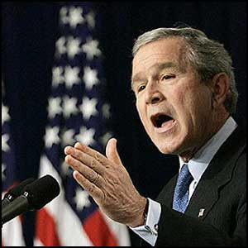
“Every nation, in every region, now has a decision to make. Either you are with us, or you are with the terrorists.”
{George Bush - 2001}

Slide 14
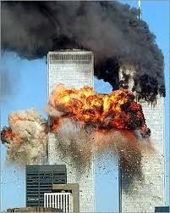
The East Wind Today
“How comes the word that I have declared that New York is to be swept away by a tidal wave? This I have never said. I have said, as I looked at the great buildings going up there, story after story, 'What terrible scenes will take place when the Lord shall arise to shake terribly the earth! Then the words of Rev. 18:1-3 will be fulfilled.' The whole of the eighteenth chapter of Revelation is a warning of what is coming on the earth. But I have no light in particular in regard to what is coming on New York, only that I know that one day the great buildings there will be thrown down by the turning and overturning of God's power. From the light given me, I know that destruction is in the world. One word from the Lord, one touch of his mighty power, and these massive structures will fall. Scenes will take place the fearfulness of which we cannot imagine." {Review and Herald, July 5, 1906 par. 14, and Life Sketches 411.5}

Slide 15
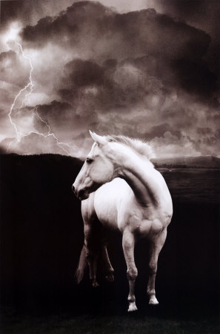
“Angels are holding the four winds, which are represented as an angry horse seeking to break loose and rush over the face of the whole earth, bearing destruction and death in its path... While their hands were loosening, and the four winds were about to blow, the merciful eye of Jesus gazed on the remnant that were not sealed, and He raised His hands to the Father and pleaded with Him that He had spilled His blood for them. Then another angel was commissioned to fly swiftly to the four angels and bid them hold until the servants of God were sealed with the seal of the living God in their foreheads."
{My Life Today, 308}

Slide 16
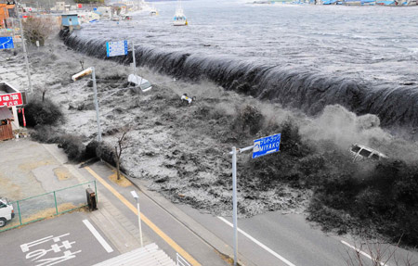
Japan

Slide 17
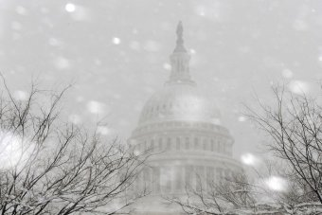
Record Snowfall in the States

Slide 19
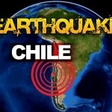
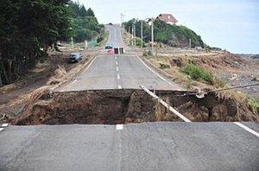
The earthquake that struck Chile was so powerful that it appears to have jolted Earth's axis into a new position and increased our planet's rotation speed. Calculations by a research scientist at NASA's Jet Propulsion Laboratory indicate the earthquake shortened the length of a day on Earth by more than one-millionth of a second. The U.S. space agency's Richard Gross used a complex mathematical model to simulate the earthquake's effect. He estimates that our days are now 0.00000126 seconds shorter than they were last week. That's 1.26 microseconds, or millionths of a second, and Gross says the change will be permanent. Earth's axis also was pushed about eight centimeters away from its normal position by the earthquake on Saturday - one centimeter more than the displacement produced by the mighty Sumatra earthquake of December 2004.

Slide 20
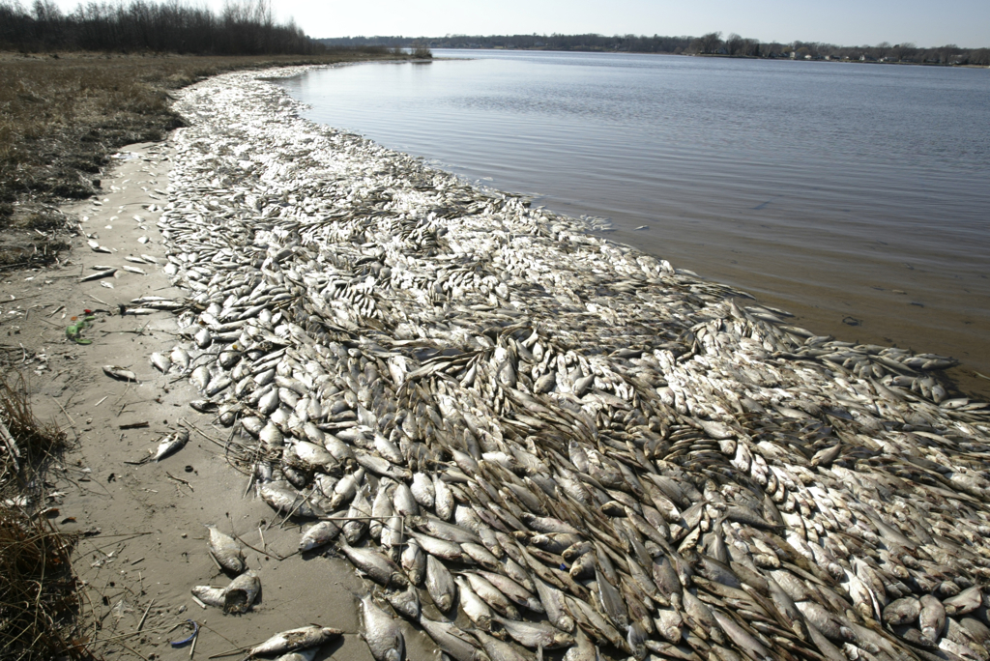

Slide 21
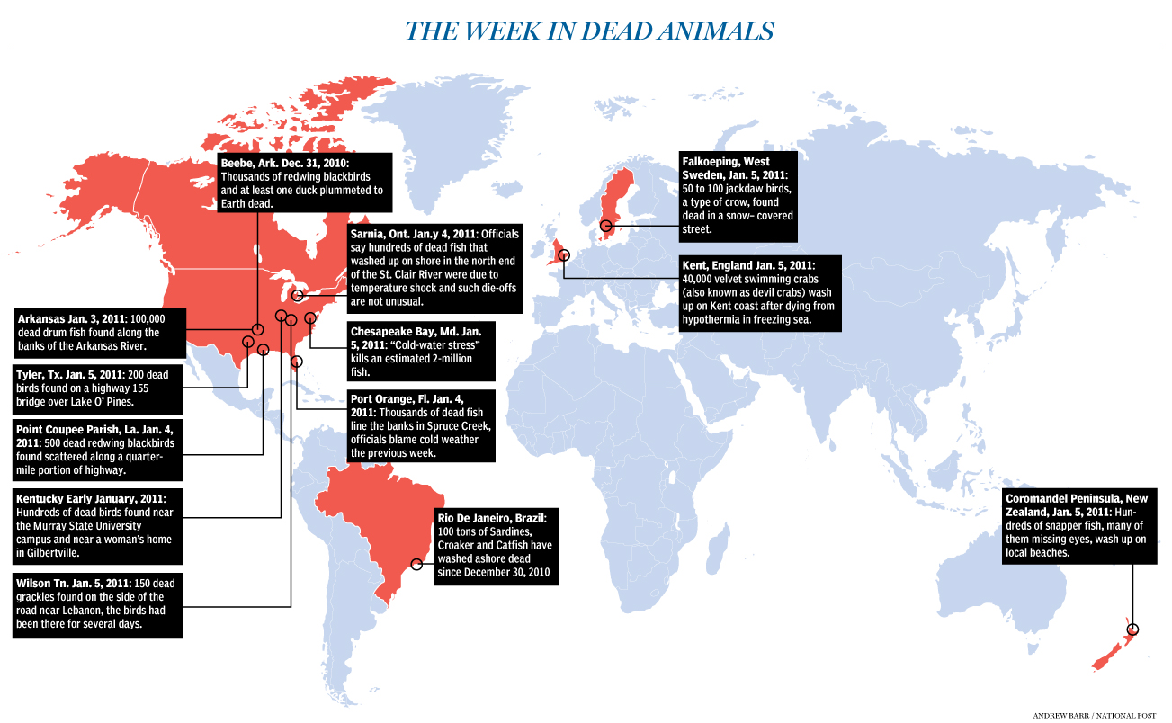

Slide 22
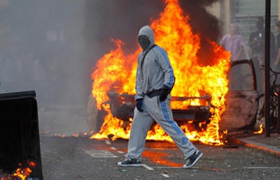
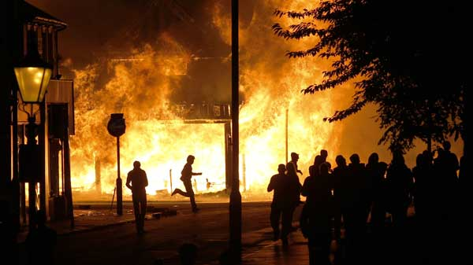

Slide 23
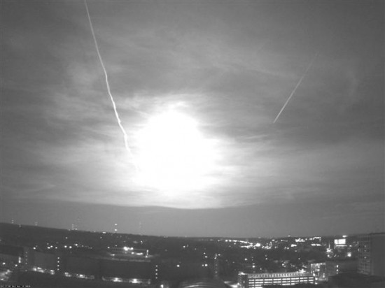

Slide 24
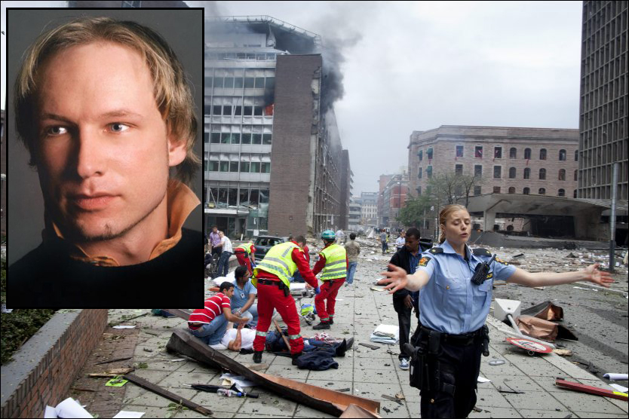

Slide 25
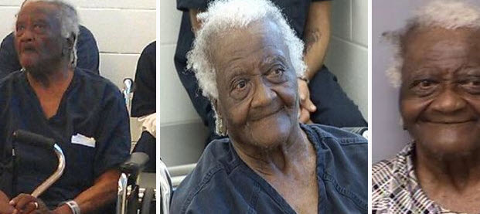

Slide 26
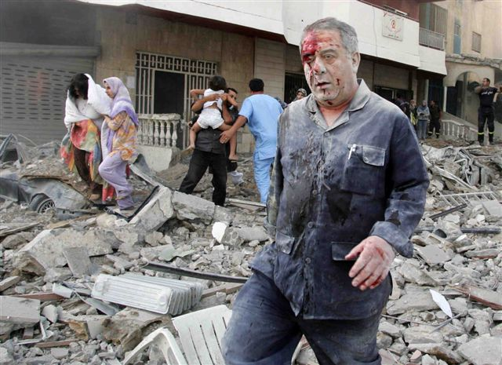
Distress of Nations

Slide 27
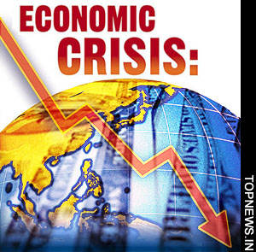
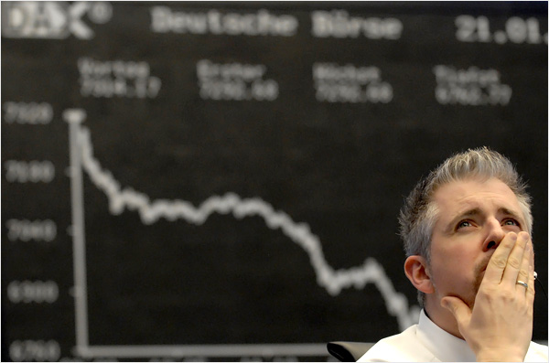

Slide 28
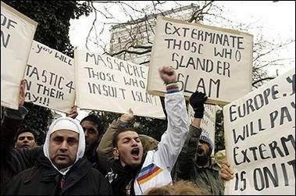
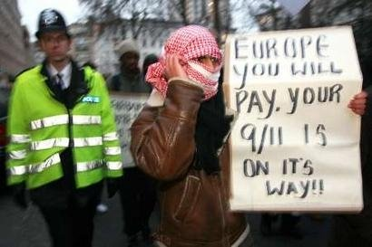

Slide 29
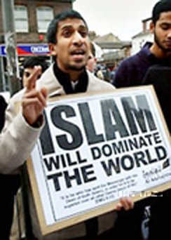
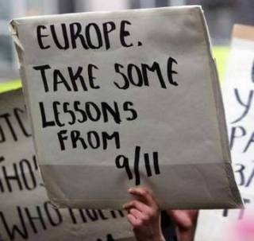

Slide 30
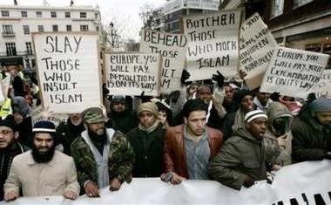
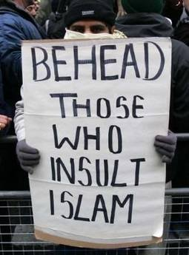

Slide 31
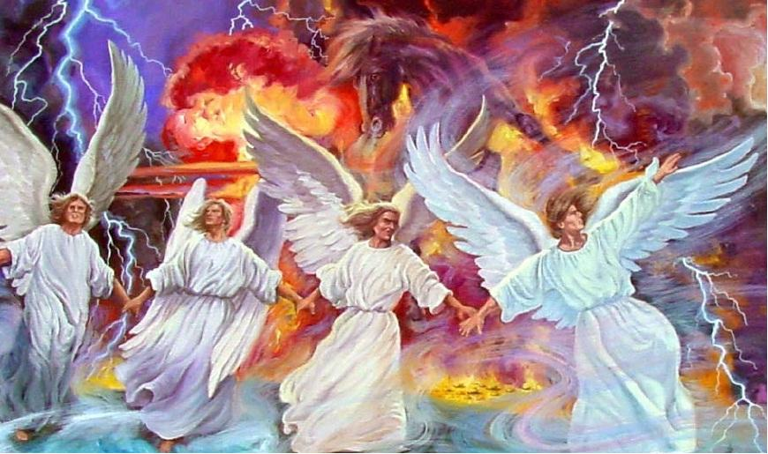
Already the restraining Spirit of God is being withdrawn from the world. Hurricanes, storms, tempests, fire and flood, disasters by sea and land, follow each other in quick succession. Science seeks to explain all these. The signs thickening around us, telling of the near approach of the Son of God, are attributed to any other than the true cause. People cannot discern the sentinel angels restraining the four winds, that they shall not blow until the servants of God are sealed. But when God shall bid His angels loose the winds, there will be such a scene of strife as no pen can picture. {CTr 316.3}
We are standing on the threshold of great and solemn events. Prophecy is fast fulfilling. The Lord is at the door. There is soon to open before us a period of overwhelming interest to all who are living. The controversies of the past are to be revived. New controversies will arise. The scenes to be enacted in our world are not even dreamed of. Satan is at work through human agencies. {CTr 316.4}

Slide 32
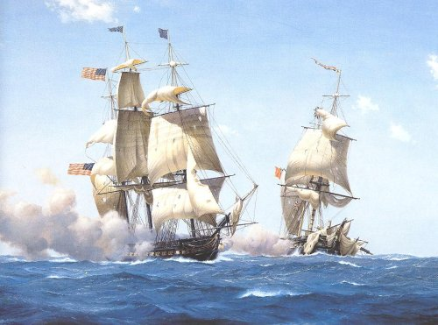
Thou breakest the ships of Tarshish with an east wind. {Psalm 48:7}

Slide 33
“Thy rowers have brought thee into great waters: the east wind hath broken thee in the midst of the seas” {Ezekiel 27:26}

Slide 34
“There is no such thing as a free lunch, and there is no such thing as a free war. The Iraq adventure has seriously weakened the U.S. economy, whose woes now go far beyond loose mortgage lending. You can't spend $3 trillion -- yes, $3 trillion -- on a failed war abroad and not feel the pain at home.” { Washington Post Linda J. Bilmes and Joseph E. Stiglitz - Sunday, March 9, 2008 }

Slide 35
One who sees beneath the surface, who reads the hearts of all men, says of those who have had great light: "They are not afflicted and astonished because of their moral and spiritual condition." Yea, they have chosen their own ways, and their soul delighteth in their abominations. I also will choose their delusions, and will bring their fears upon them; because when I called, none did answer; when I spake, they did not hear: but they did evil before Mine eyes, and chose that in which I delighted not." "God shall send them strong delusion, that they should believe a lie," because they received not the love of the truth, that they might be saved," "but had pleasure in unrighteousness." Isaiah 66:3, 4; 2 Thessalonians 2:11, 10, 12.

Slide 36
The heavenly Teacher inquired: "What stronger delusion can beguile the mind than the pretense that you are building on the right foundation and that God accepts your works, when in reality you are working out many things according to worldly policy and are sinning against Jehovah? Oh, it is a great deception, a fascinating delusion, that takes possession of minds when men who have once known the truth, mistake the form of godliness for the spirit and power thereof; when they suppose that they are rich and increased with goods and in need of nothing, while in reality they are in need of everything." {8T 249.3}

Slide 37
In the probationary time granted us here we are each building a structure that is to have the inspection of the Judge of all the earth. This work is the molding of our characters. Every act of our lives is a stone in that building, every faculty is a worker, every blow that is struck is for good or for evil. The words of inspiration warn us to take heed how we build, to see that our foundation is sure. If we build upon the solid rock, pure, noble, upright deeds, the structure will go up beautiful and symmetrical, a fit temple for the indwelling of the Holy Spirit. {HP 47.4}

Slide 38
“In every generation and in every land the true foundation and pattern for character building have been the same. The divine law, "Thou shalt love the Lord thy God with all thy heart, . . . and thy neighbour as thyself" (Luke 10:27), the great principle made manifest in the character and life of our Saviour, is the only secure foundation and the only sure guide.” {Mar 146.6}

Slide 39
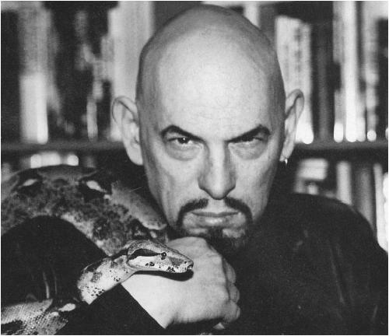

Slide 40
“Reformatory action is always attended with sacrifice. It demands that love of ease, selfish interest, and the lust of ambition be held in subjection to the principles of right.”
{4T 636.2}

Slide 41
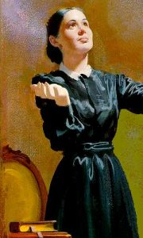
God enjoins upon all His followers to bear a living testimony in unmistakable language by their conduct, their dress and conversation, in all the pursuits of life, that the power of true godliness is profitable to all in this life and in the life to come. {FLB 235.3}
A cheap Christian character works more harm in the world than the character of a worldling, for professed Christians mislead others by professing to represent Him whose name they assume.
God is love. Whoso dwelleth in God, dwelleth in love. All who have indeed become acquainted . . . with the love and tender compassion of our heavenly Father will impart light and joy wherever they may be. Their presence and influence will be to their associates as the fragrance of sweet flowers, because they are linked to God and heaven, and the purity and exalted loveliness of heaven are communicated through them to all that are brought within their influence. {FLB 235}

